Slide 1

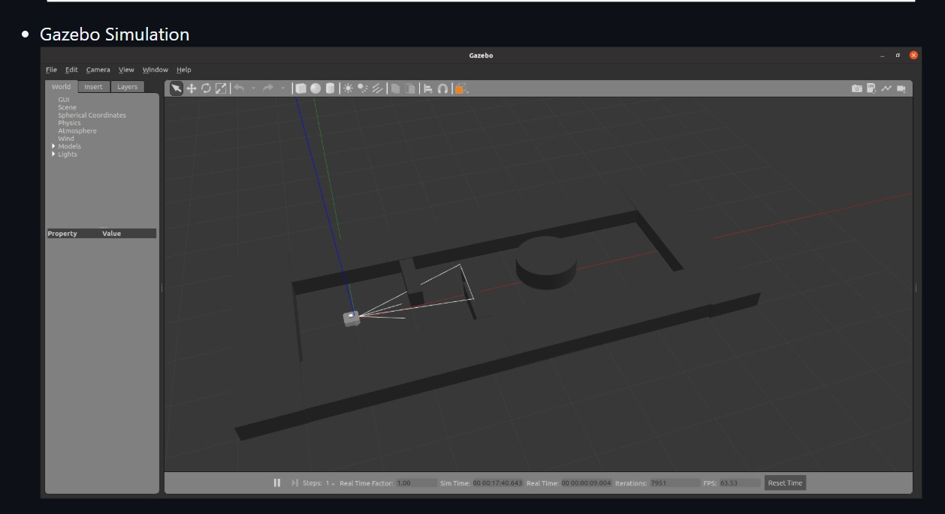
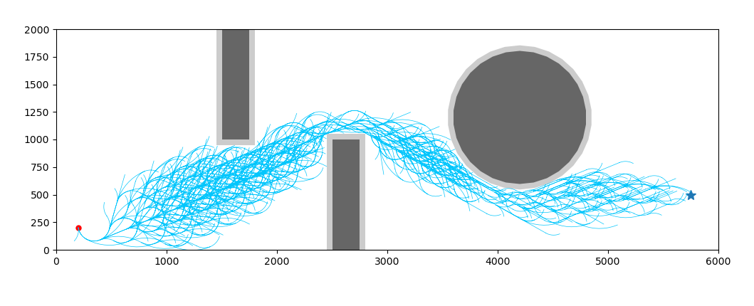
A* PATH PLANNING BASED ROBOT NAVIGATION
Rachamadugu Subramanya Buvan, Kommineni Akhil Shivaram , Dr.Shailesh Khapre.
Overview
A* Path Planning
This project implements a path planning technique using the A* algorithm for a TurtleBot3 Waffle robot inside a Gazebo simulation environment. The goal of this work is to help users understand how A* algorithm finds the shortest path in robot navigation tasks. The simulation allows users to explore different start and goal positions and observe how the algorithm adapts to changes in real-time. This helps in visualizing the path planning process clearly and understanding the role of algorithm parameters in a robot’s navigation task.
The A* algorithm is used for robot navigation by calculating the optimal path between two points based on the lowest cost. The algorithm balances two values: the cost from the start to a node and an estimated cost from that node to the goal. This helps the robot select the most efficient route. In this project, A* helps TurtleBot3 to plan paths inside a Gazebo simulation environment using the provided coordinates and movement parameters.
Fig 1: A* path planning
Simulation Board
Simulation Board
In this project, the simulation process is divided into two stages: path planning and path execution.
The A* algorithm first computes the most efficient route from the start to the goal while avoiding
obstacles, and then this path is executed inside the Gazebo simulation environment. The robot
dynamically follows the computed path while continuously adjusting for real-world factors such as
localization shifts, sensor noise, and unexpected obstacle appearances. This process helps validate
both the algorithm’s planning accuracy and the real-time robustness of the robot's navigation system.
Conclusion
Objectives:
A* path planning is a well-known graph search algorithm that calculates the shortest collision-free path from the start to the goal. The algorithm uses a cost-based approach to select the most efficient path while avoiding obstacles. The main objectives of this project are:
* Compute the shortest and safest path for a robot.
*Adapt to dynamic start and goal points.
*Avoid obstacles effectively.
*Visualize robot movement and the planned path.
*Simulate path following using Gazebo and ROS2.
Our experiments showed that our approach can
enhance the efficiency of path planning by finding
the shortest and safest route for the robot.
We achieved improved navigation even in
dynamic environments, where the robot
successfully adapted to changing obstacles and
goal positions. The system's performance
demonstrates the practical feasibility of A* path
planning in robotic applications. Further
optimization of tuning parameters can potentially
improve navigation speed and accuracy, and we
plan to explore this as part of future work.

